Slide 1
Control Structures
Conditional Statements:
If
    if (expression) {
    statement
    }
EX: <?php $secretNumber = 453;
if ($_POST['guess'] == $secretNumber) {
echo "<p>Congratulations!</p>";
} ?>
------------------------------------------------------------------------------------------------------
Can be typed as:
if ($_POST['guess'] == $secretNumber) echo "<p>Congratulations!</p>";

Slide 2
Control Structures
else
<?php
        $secretNumber = 453;
        if ($_POST['guess'] == $secretNumber) {
        echo "<p>Congratulations!!</p>";
        } else {
        echo "<p>Sorry!</p>";
        } ?>
  ------------------------------------------------------------------------------------------------------

Slide 3
Control Structures
elseif
      <?php
      $secretNumber = 453;
      $_POST['guess'] = 442;
      if ($_POST['guess'] == $secretNumber) {
      echo "<p>Congratulations!</p>";
      } elseif (abs ($_POST['guess'] - $secretNumber) < 10) {
      echo "<p>You're getting close!</p>";
      } else {
      echo "<p>Sorry!</p>";
      }
      ?>
------------------------------------------------------------------------------------------------------

Slide 4
Control Structures
switch
<?php switch($category) {
        case "news":
        print "<p>What's happening around the World</p>";
        break;
        case "weather":
        print "<p>Your weekly forecast</p>";
        break;
        case "sports":
        print "<p>Latest sports highlights</p>";
        break;
        default:
        print "<p>Welcome to my Web site</p>";
  } ?>
------------------------------------------------------------------------------------------------------

Slide 5
Control Structures
Looping Statements:
while
      while (expression) {
      statements
      }
EX:
    <?php
    $count = 1;
    while ($count < 5) {
    echo "$count squared = ".pow($count,2). "<br />";
    $count++;
    }
    ?>
The output is: 1 squared = 1 2 squared = 4 3 squared = 9 4 squared = 16

Slide 6
Control Structures
do…while
        do {
        statements
        } while (expression);
  EX:
      <?php
      $count = 11;
      do {
      echo "$count squared = ".pow($count,2). "<br />";
      } while ($count < 10);
      ?>
------------------------------------------------------------------------------------------------------
The outcome is: 11 squared = 121

Slide 7
Control Structures
do…while
        do {
        statements
        } while (expression);
  EX:
      <?php
      $count = 11;
      do {
      echo "$count squared = ".pow($count,2). "<br />";
      } while ($count < 10);
      ?>
------------------------------------------------------------------------------------------------------
The outcome is: 11 squared = 121

Slide 8
Control Structures
do…while
        do {
        statements
        } while (expression);
  EX:
      <?php
      $count = 11;
      do {
      echo "$count squared = ".pow($count,2). "<br />";
      } while ($count < 10);
      ?>
------------------------------------------------------------------------------------------------------
The outcome is: 11 squared = 121

Slide 9
Control Structures
for
        for (expression1; expression2; expression3) {
        statements
        }
There are a few rules to keep in mind when using PHP’s for loops:
    • The first expression, expression1, is evaluated by default at the first
    iteration of the loop.
    • The second expression, expression2, is evaluated at the beginning
    of each iteration. This expression determines whether looping will
    continue.
    • The third expression, expression3, is evaluated at the conclusion of
    each loop.
    • Any of the expressions can be empty
------------------------------------------------------------------------------------------------------
The outcome is: 11 squared = 121

Slide 10
Control Structures
  EX:
    // Example One
      for ($kilometers = 1; $kilometers <= 5; $kilometers++) {
      echo "$kilometers kilometers = ".$kilometers*0.62140. " miles";
      }
    // Example Two
      for ($kilometers = 1; ; $kilometers++) {
      if ($kilometers > 5) break;
      echo "$kilometers kilometers = ".$kilometers*0.62140. "miles ";
      }
    // Example Three
      $kilometers = 1;
      for (;;) {
      if ($kilometers > 5) break;
      echo "$kilometers kilometers = ".$kilometers*0.62140. " miles ";
      $kilometers++;
      }

Slide 11
Control Structures
foreach
      foreach (array_expr as $value) {
        statement
        }
  EX:
  <?php
  $links = array("www.apress.com","www.php.net","www.apache.org");
    echo "<b>Online Resources</b>:<br />";
    foreach($links as $link) {
  echo "<a href="http://$link\">$link</a><br />";
    }
  ?>
------------------------------------------------------------------------------------------------------

Slide 12
Control Structures
The second variation is well-suited for working with both the key and value of
an array. The syntax follows:
        foreach (array_expr as $key => $value) {
        statement
        }
EX: If the $links array contained both a link and corresponding link title:
<?php $links = array("The Official Apache Web site" => "www.apache.org",
  "The Apress corporate Web site" => "www.apress.com",
  "The Official PHP Web site" => "www.php.net");
  echo "<b>Online Resources</b>:<br />";
  foreach($links as $title => $link) {
  echo "<a href=\"http://$link\">$title</a><br />";
  }
  ------------------------------------------------------------------------------------------------------

Slide 13
Control Structures
break
    <?php
      $primes = array(2,3,5,7,11,13,17,19,23,29,31,37,41,43,47);
      for($count = 1; $count++; $count < 1000) {
      $randomNumber = rand(1,50);
      if (in_array($randomNumber,$primes)) {
      break;
      } else {
      echo "<br>Non-prime number encountered: $randomNumber ";
      }
      }
      ?>
------------------------------------------------------------------------------------------------------

Slide 14
Control Structures
continue
  <?php
  $usernames = array("grace","doris","gary","nate","missing","tom");
    for ($x=0; $x < count($usernames); $x++) {
    if ($usernames[$x] == "missing") continue;
    echo "Staff member: $usernames[$x] <br />";
    }
    ?>
------------------------------------------------------------------------------------------------------

Slide 15
File Inclusion Statements
Good programmers are always thinking in terms of ensuring reusability
and modularity. The most prevalent means for ensuring such is by isolating
functional components into separate files, and then reassembling those files
as needed. PHP offers 4 statements for including such files into applications.
1. Include include (/path/to/filename)
The include() statement will evaluate and include a file into the location
where it is called. Including a file produces the same result as copying the
data from the file specified into the location in which the statement appears.
For example, if you wanted to include a series of predefined functions and
configuration variables, you could place them into a separate file (called
init.php, for example), and then include that file within the top of each PHP
script, like this:
<?php
include "/usr/local/lib/php/wjgilmore/init.php";
/* the script continues here */ ?>
------------------------------------------------------------------------------------------------------

Slide 16
File Inclusion Statements
Note: if you use the include() in a conditional ,you have to enclose the
statement block between curly brackets.
  EX:
      <?php
      if (expression) {
      include ('filename');
      } else {
      include ('another_filename');
      } ?>
------------------------------------------------------------------------------------------------------

Slide 17
File Inclusion Statements
include_once() include_once (filename)
The include_once() function has the same purpose as include(), except
that it first verifies whether or not the file has already been included. If it has
been, include_once() will not execute. Otherwise, it will include the file as
necessary.
require() require (filename)
The require() function operates like include(), but There are two differences:
The first difference, When a script is processed, PHP replaces instances of the require statement with the contents of the file to be included, even if the line containing the require statement is never executed. But , the include statement is processed only when the statement is executed and returns a true or false, depending on whether the statement is executed correctly.
The second difference is that script execution will stop if a require() fails,
Whereas it may continue in the case of an include().

Slide 18
File Inclusion Statements
require_once require_once (insertion_file)
The require_once() function ensures that the inclusion file is included
only once in your script. After require_once() is encountered, any subsequent
attempts to include the same file will be ignored.
------------------------------------------------------------------------------------------------------

Slide 19
Functions
Invoking a Function
<?php
        $value = pow(5,3); // returns 125
        echo $value; ?>
    Or
    echo "Five raised to the third power equals ".pow(5,3).".";
Creating Function:
function function_name (parameters) {
function-body
}
For example:
function generate_footer() {
echo "<p>Copyright &copy; 2006 W. Jason Gilmore</p>";
}
you can then call the function : generate_footer();
------------------------------------------------------------------------------------------------------

Slide 20
Functions
Passing argument by value
<?php function salestax($price,$tax) {
      $total = $price + ($price * $tax);
      echo "Total cost: $total";
      }
      $pricetag = 15.00;
      $salestax = .075;
      salestax($pricetag, $salestax);//call statment
      ?>
------------------------------------------------------------------------------------------------------

Slide 21
Functions
Passing argument by Reference
<?php
$cost = 20.00;
$tax = 0.05;
function calculate_cost(&$cost, $tax)
{
// Modify the $cost variable
$cost = $cost + ($cost * $tax);
// Perform some random change to the $tax variable.
$tax += 4;
}
calculate_cost($cost,$tax);
echo "Tax is: ". $tax*100%"<br />";
echo "Cost is: $". $cost."<br />";
?>
------------------------------------------------------------------------------------------------------
The output: Tax is 5% Cost is $21

Slide 22
Functions
Default Argument Values
Default values can be assigned to input arguments, which will be automatically
assigned to the argument if no other value is provided.
<?php function salestax($price,$tax=.05) {
$total = $price + ($price * $tax);
echo "Total cost: $total";
}
$price = 12.0;
salestax($price,0.02); ?>
Keep in mind that you can still pass $tax another taxation rate; 5.0 percent
will be used only if salestax() is invoked like this: salestax($price);
Note: the default argument values must be constant expressions; you
cannot assign nonconstant values such as function calls or variables.
------------------------------------------------------------------------------------------------------

Slide 23
Functions
Optional Arguments
You can designate certain arguments as optional by placing them at the end
of the list and assigning them a default value of nothing, like so:
<?php function salestax($price,$tax="") {
$total = $price + ($price * $tax);
echo "Total cost: $total";
} ?>
This allows you to call salestax() without the second parameter if there is no
sales tax: salestax(42.00);
This returns the following: Total cost: $42.00
------------------------------------------------------------------------------------------------------

Slide 24
Functions
If multiple optional arguments are specified, you can selectively choose
which ones are passed along. Consider this example:
  function calculate($price,$price2="",$price3="") {
  echo $price + $price2 + $price3;
  }
You can then call calculate(), passing along just $price and $price3, like so:
  calculate(10,"",3);
  This returns the following value: 13
------------------------------------------------------------------------------------------------------

Slide 25
Functions
Returning values from a function
return()
The return() statement returns any resulting value back to the function caller
function salestax($price,$tax=.0575) {
$total = $price + ($price * $tax);
return $total;
}
Alternatively, you could return the calculation directly without even assigning
it to $total, like this:
function salestax($price,$tax=.0575) {
return $price + ($price * $tax);
}
call statement can be : <?php $price = 6.50;
$total = salestax($price); ?>
------------------------------------------------------------------------------------------------------

Slide 26
Functions
Returning Multiple values
<?php $colors = array("red","blue","green");
list($red,$blue,$green) = $colors;
// $red="red", $blue="blue",$green="green“ ?>
Building on this example, you can imagine how the three prerequisite values
might be returned from a function using list():
<?php
function retrieve_user_profile() {
$user[] = "Jason";
$user[] = "jason@example.com";
$user[] = "English";
return $user; }
list($name,$email,$language) = retrieve_user_profile();
echo "Name: $name, Email: $email, Language: $language"; ?>
Output is : Name: Jason, email: jason@example.com, preferred language: English
------------------------------------------------------------------------------------------------------

Slide 27
Functions
Variable Functions
A variable function is a function whose name is evaluated before execution,
which is mean the exact name of the function is not known until execution
time. Variable functions are prefaced with a dollar sign, just like regular
variables, like this: $function();
For example: if we have a number of functions to retrieve several data :
retrieveUser(), retrieveNews(), and retrieveWeather(), where the name of
each function implies its purpose.
Solution by if statement:
<?php if ($trigger == "retrieveUser") {
retrieveUser($rowid);
} else if ($trigger == "retrieveNews") {
retrieveNews($rowid);
} else if ($trigger == "retrieveWeather") {
retrieveWeather($rowid); } ?>

Slide 28
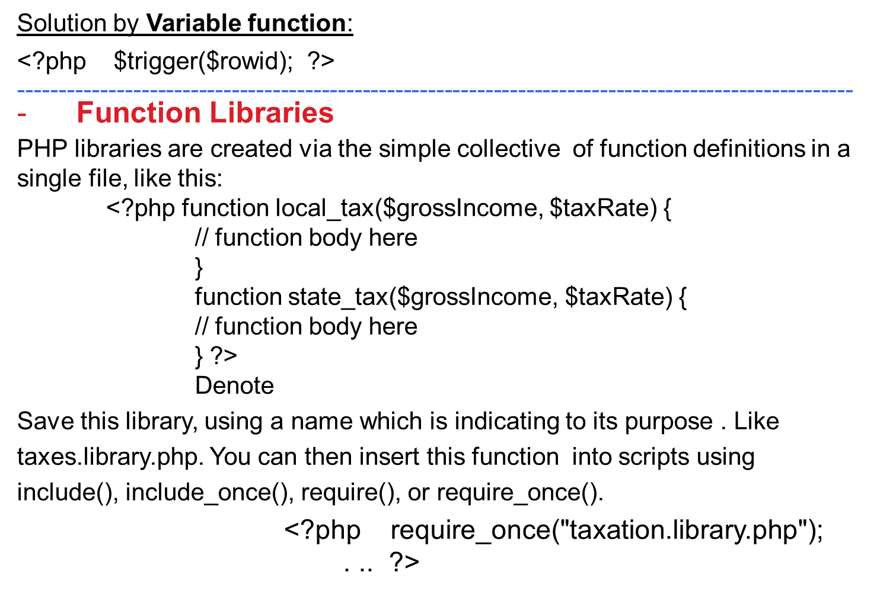
Functions

